Slide 1


Cryptocurrency Analysis
Comprehensive crypto analysis tool for real-time market insights.

Slide 2

Why Crypto Currency Analysis Matters
1
Understanding Market Trends
2
Making Informed Decisions
The cryptocurrency market is volatile and dynamic, with prices constantly fluctuating. Analysis can help investors navigate this complex landscape.
By analyzing data, investors can gain valuable insights to make informed decisions about buying, selling, or holding crypto assets.
3
Identifying Opportunities
Cryptocurrency analysis can reveal hidden trends, patterns, and opportunities that might otherwise be missed.

Slide 3
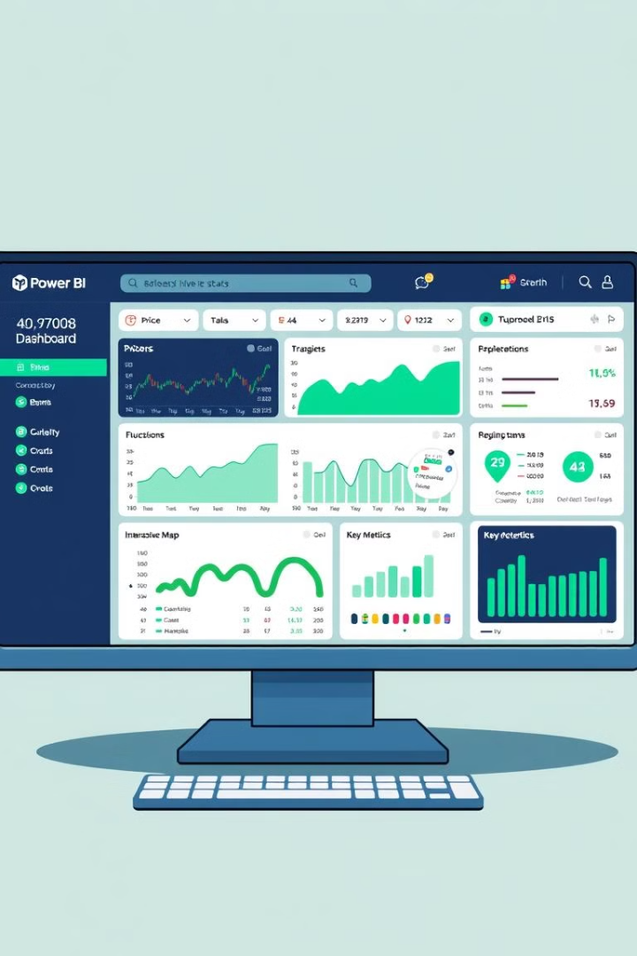
Objective of the Dashboard
Comprehensive Insights
Real-Time Updates
The dashboard updates in real-time, providing investors with up-to-the-minute information on market movements and trends.
The dashboard provides a centralized view of crucial crypto market data, allowing investors to quickly understand the current market landscape.
Interactive Exploration
Users can interact with the dashboard to drill down into specific data points, filter information, and customize their analysis.

Slide 4
Dashboard Overview
Market Trends
Volume Analysis
Performance Metrics
Visual representation of cryptocurrency price fluctuations.
Trading volume insights across multiple exchanges.
Key indicators for top-performing digital assets.

Slide 5
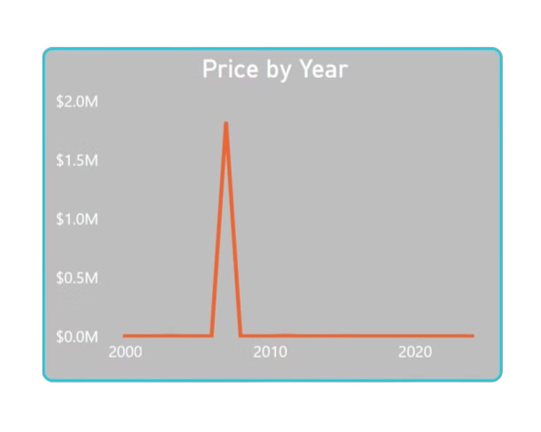
Market Overview
1
Price Trends
Historical price data for major cryptocurrencies.
2
Market Capitalization
Total value of cryptocurrencies in circulation.
3
24h Change
Percentage changes in crypto prices.

Slide 6

Volume Analysis
Exchange Volumes
Asset Dominance
Volume Trends
Trading volumes across major cryptocurrency exchanges.
Market share of top cryptocurrencies.
Historical trading volume patterns over time.

Slide 7

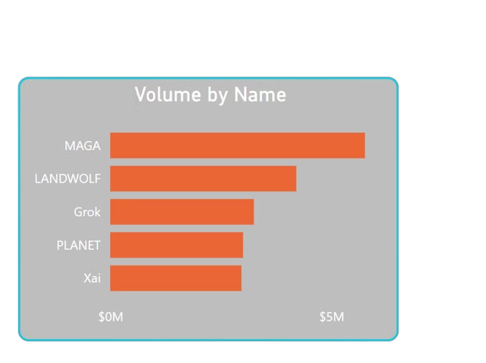


Performance Metrics
Top Gainers
Cryptocurrencies with highest percentage increases.
ROI Analysis
Return on investment for various timeframes.
Price Predictions
AI-driven forecasts for major cryptocurrencies.

Slide 8
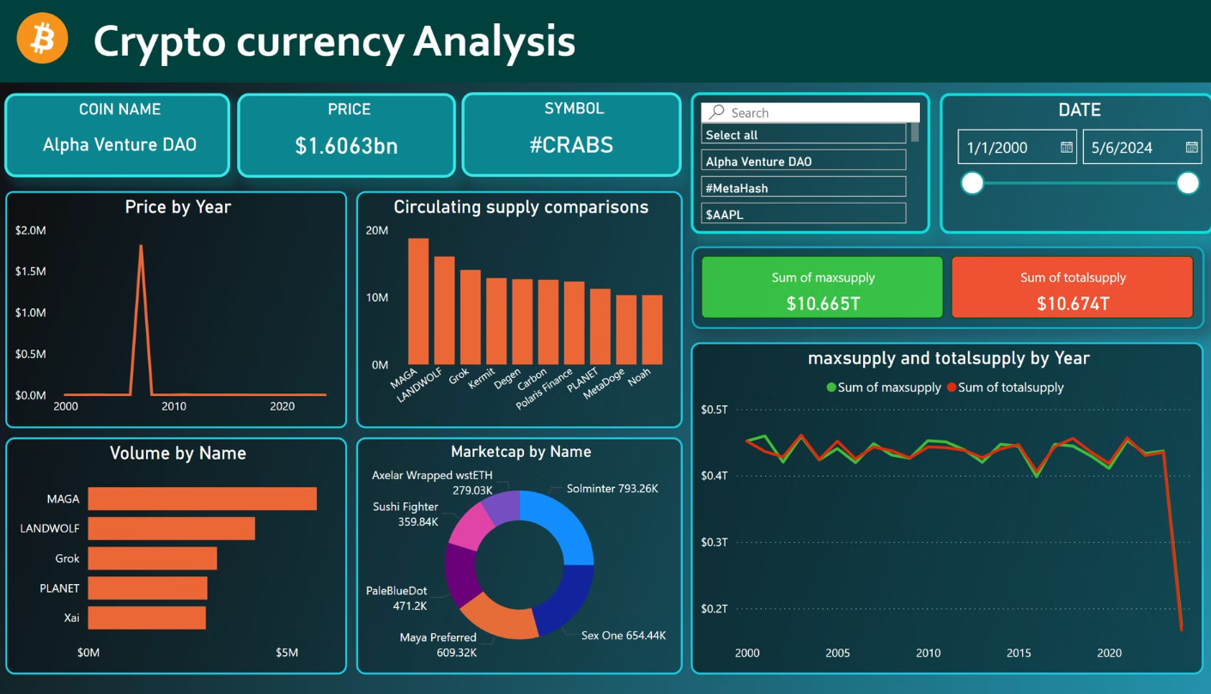
Dashboard Overview

Slide 9




Conclusion and Next Steps
Data-Driven Insights
The Power BI dashboard provides a powerful tool for data-driven decision-making in the crypto market.
Regular Reporting
Regularly analyzing and reporting on crypto trends can help investors stay informed and make informed decisions.
Collaboration and Communication
The dashboard can facilitate collaboration and communication among investors, analysts, and traders.

